Slide 1
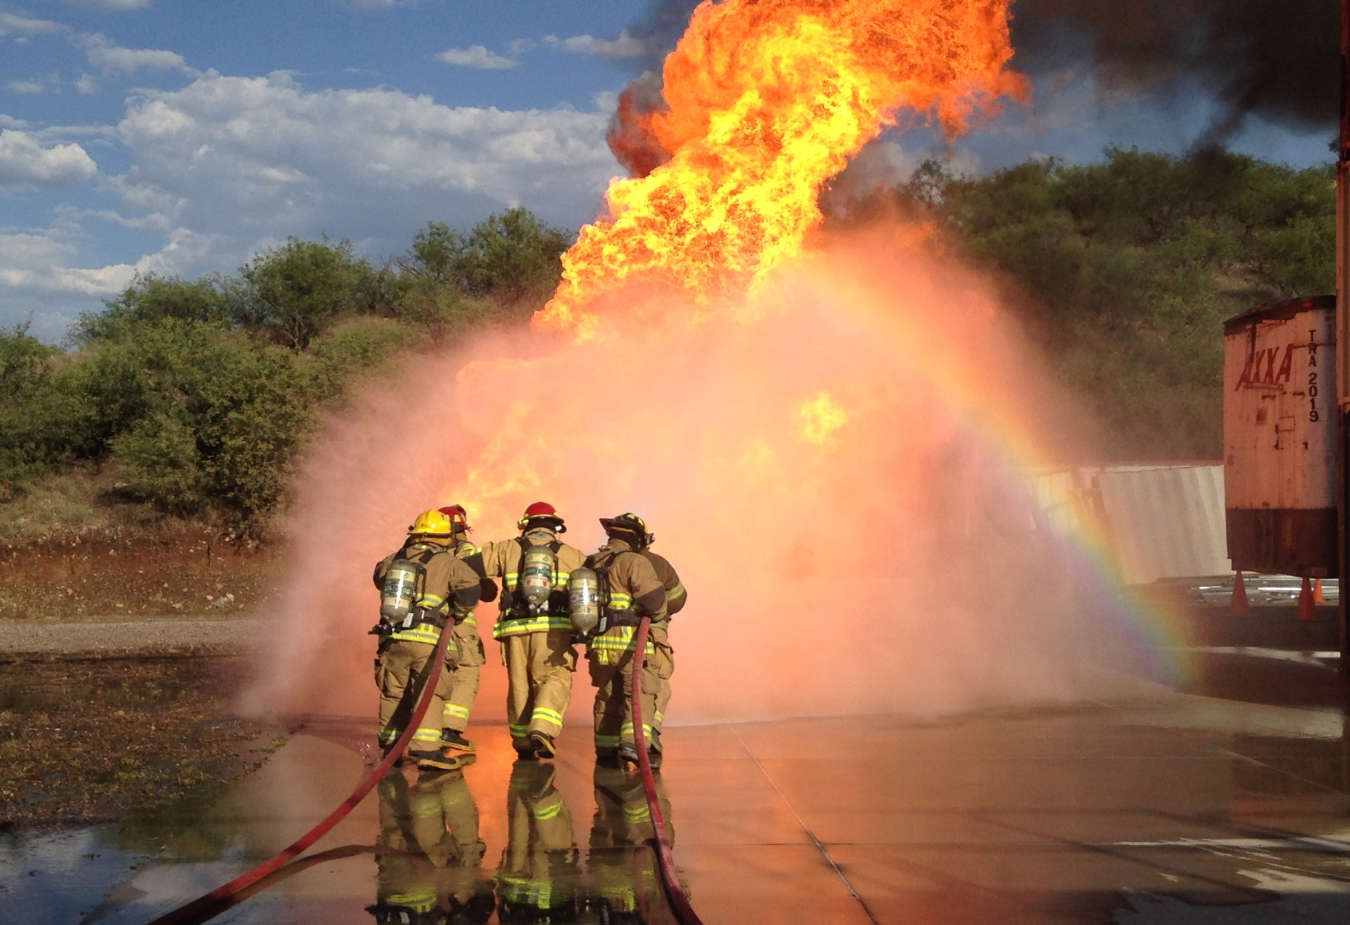



2017 Santa Cruz County Arizona
Propane Class and Live Fire Exercise

Slide 2
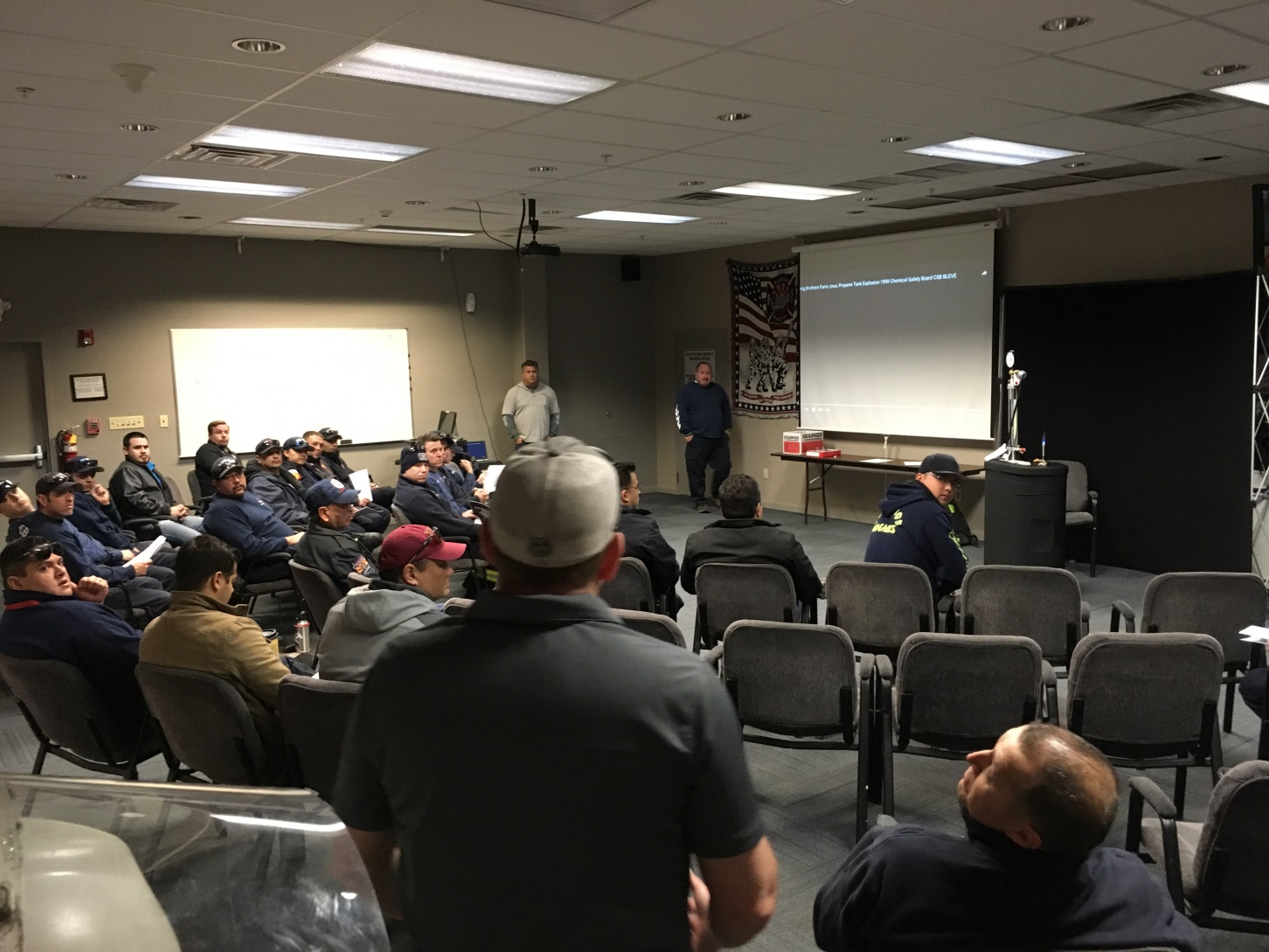

Slide 3
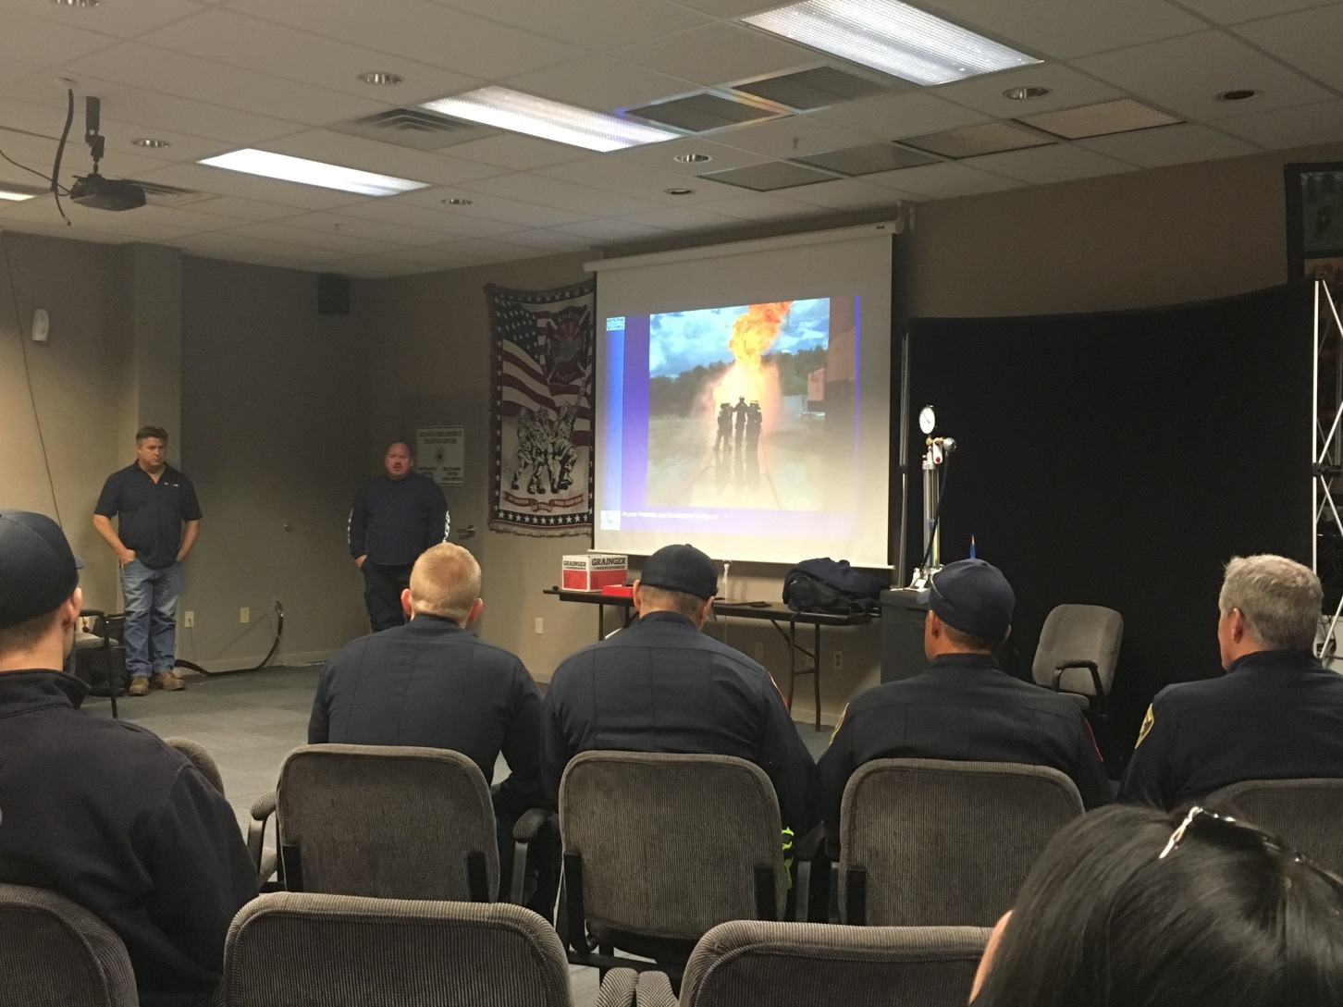

Slide 4
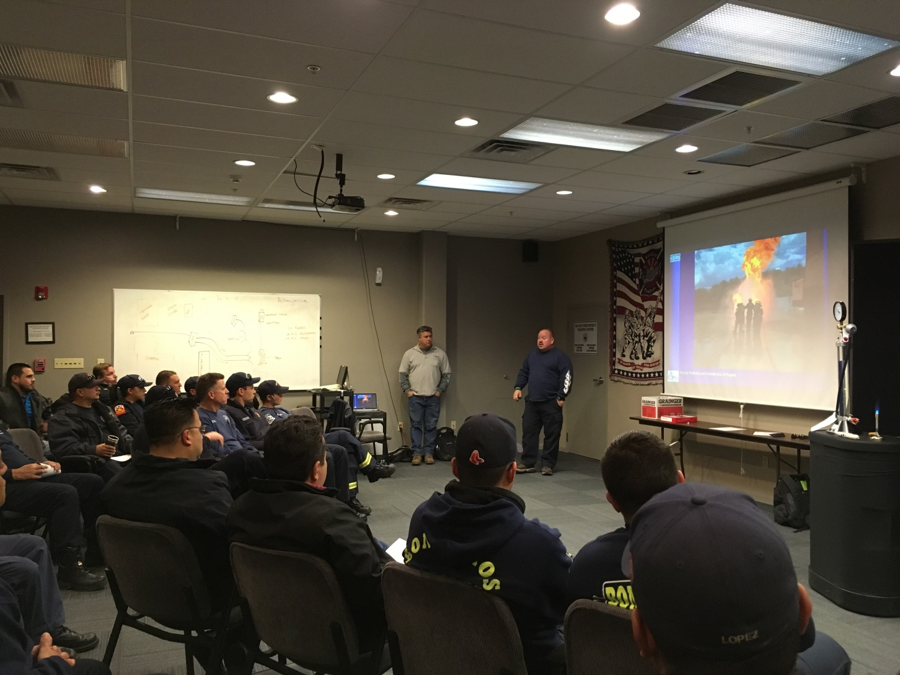

Slide 5
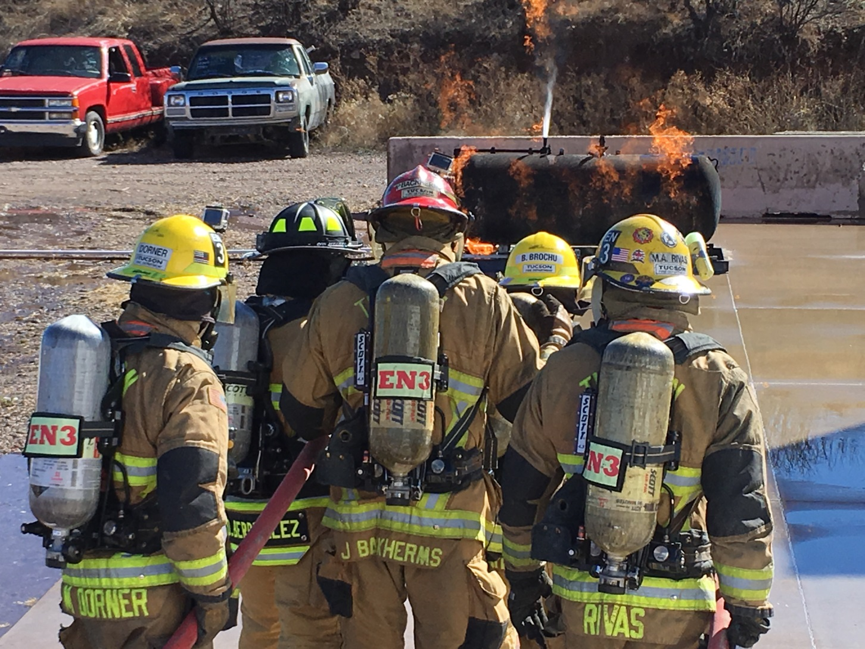

Slide 6
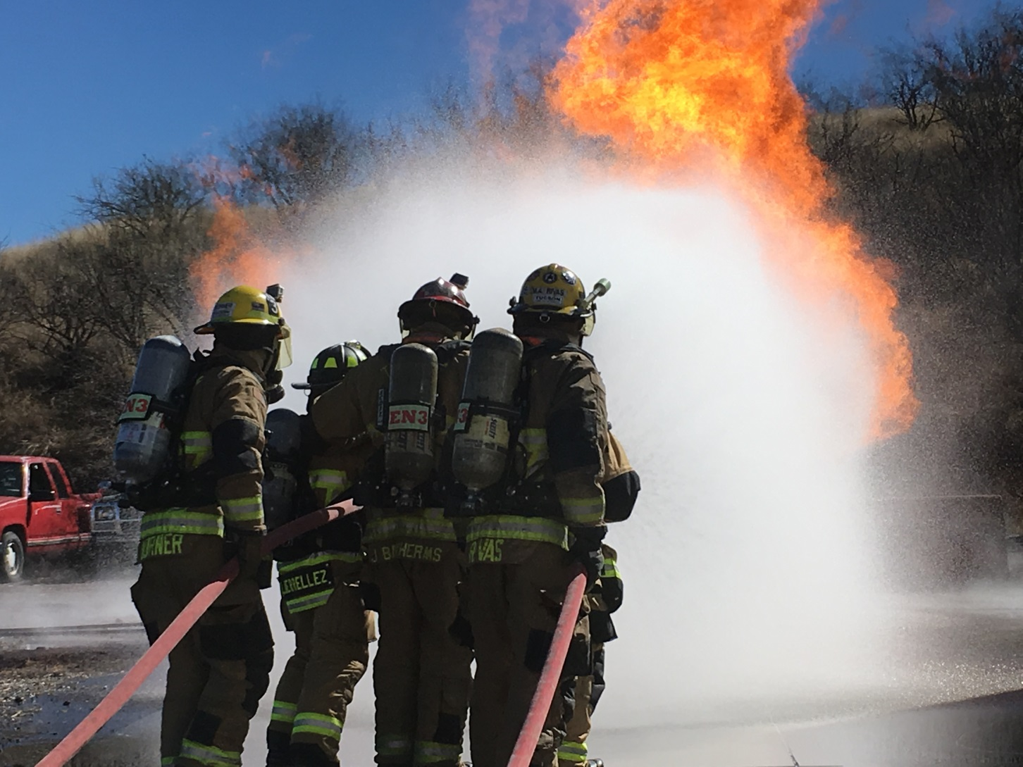

Slide 7
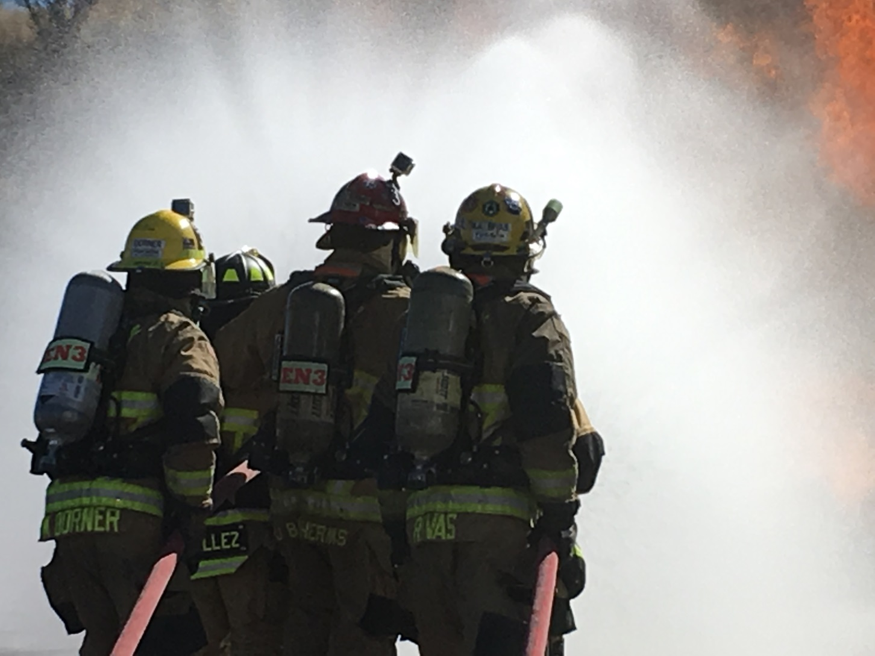

Slide 8
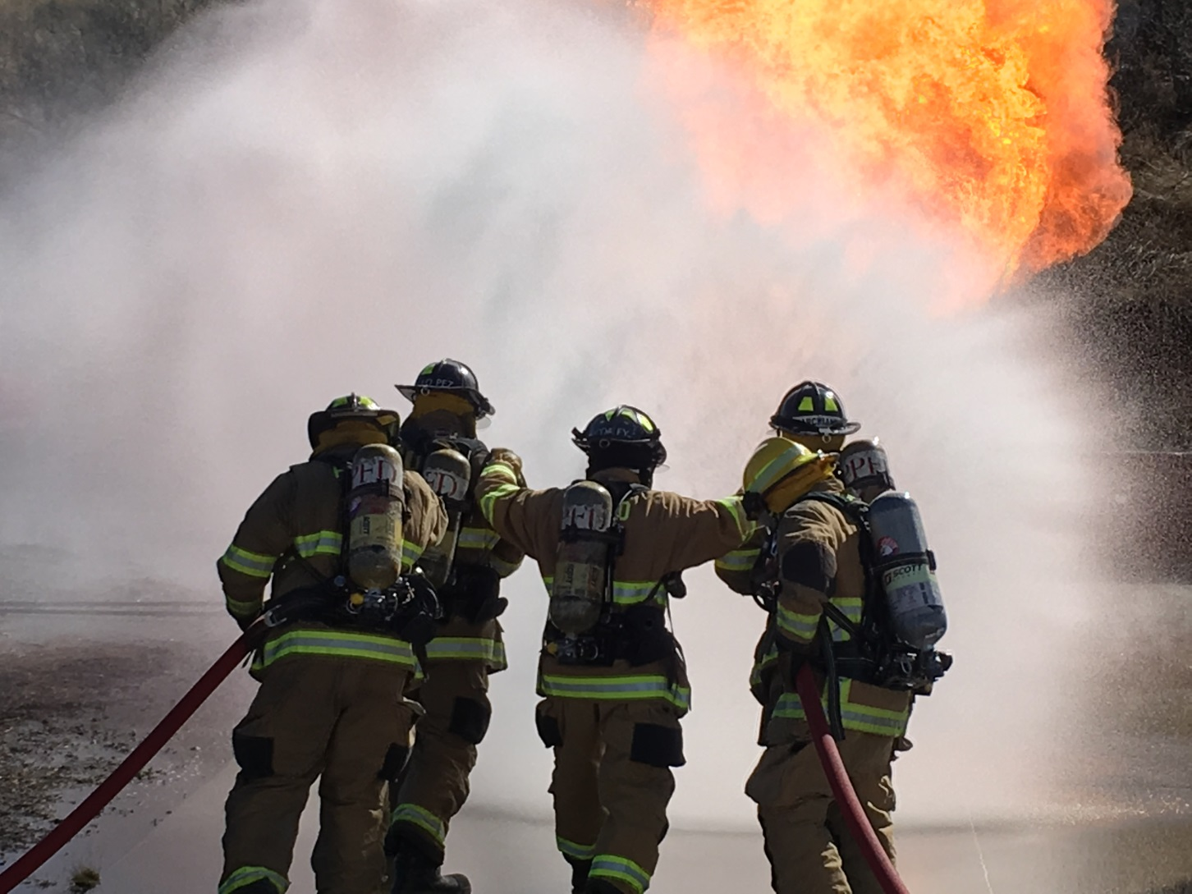

Slide 9
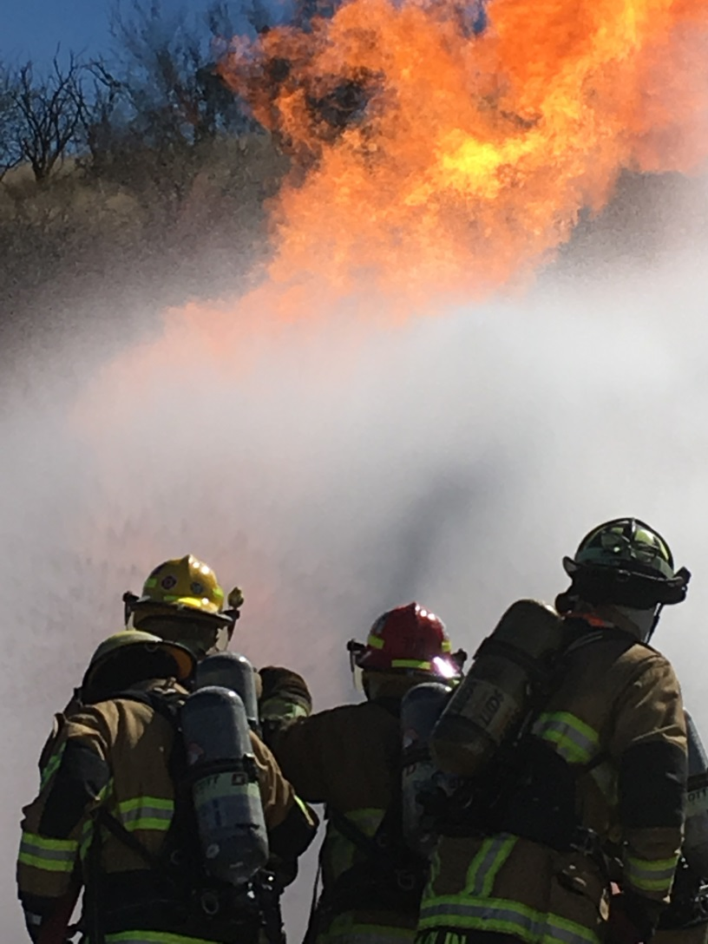

Slide 10
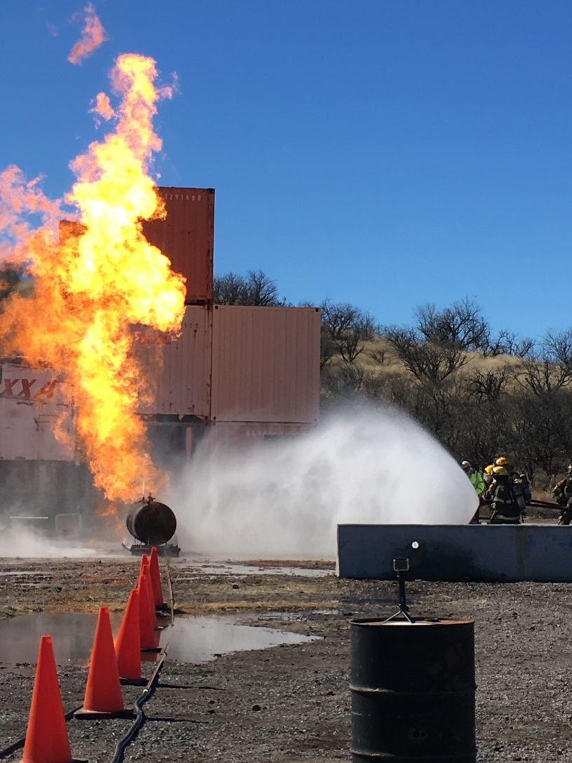

Slide 11
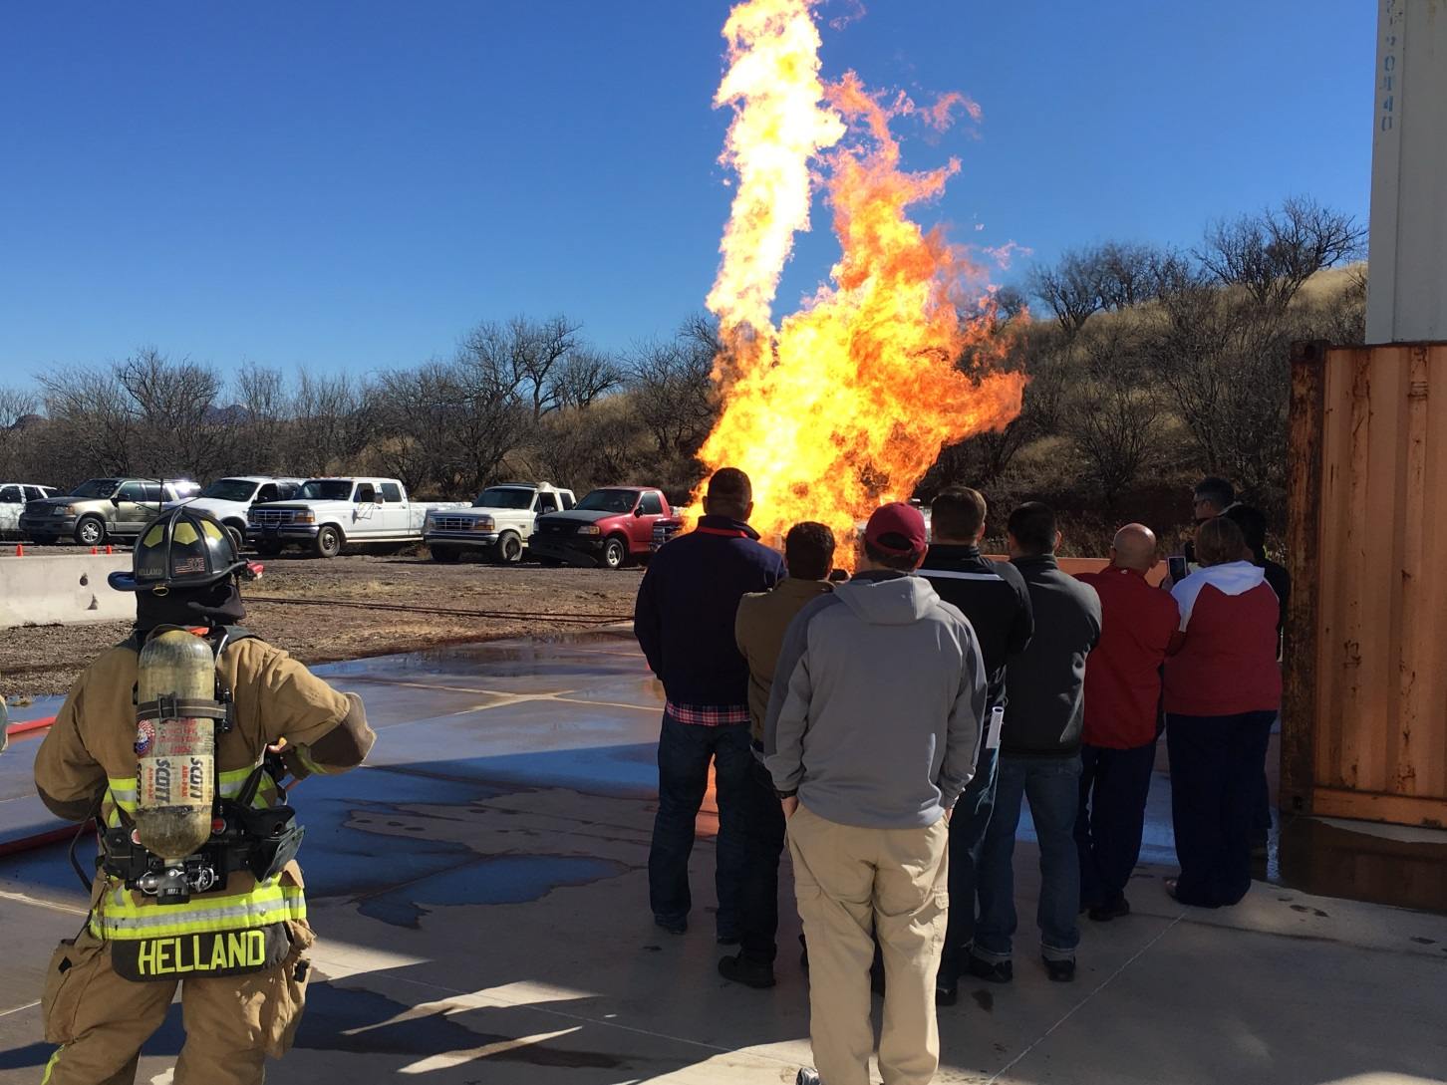

Slide 12

Questions?
Frank Granados fgranados@rioricofire.org
Ray Sayre rsayre@santacruzcountyaz.gov
Rod Jones rodney.jones@amerigas.com

