Slide 1
Lithium-Ion Battery Response Training
Firefighting Tools Evaluation

Slide 2
Disclaimer
The purpose of this section is to highlight pros and cons of certain tools marketed to first responders but should not be viewed as recommendation or review of any of the tools displayed. The list of tools should not be considered exhaustive.
The best tool is a well-trained firefighter who is informed of the hazards and risks and apply that knowledge to make decisions in a variety of situations.

Slide 3
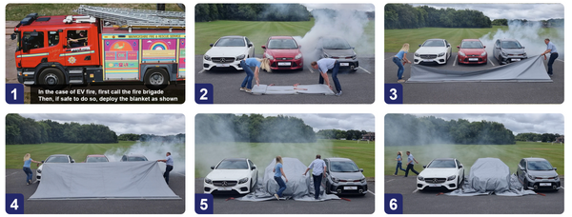
Fire Blankets
Pros
Protect exposures from radiant heat
Possible smothering/reduction of non-battery fires
Plastics, fabrics, tires, etc.
Aid in removal of smaller battery devices/systems
Reduce firefighter exposure
Contain projectile batteries
Cons
Battery fires cannot be smothered
Close engagement/proximity of fire personnel
Reduction in cooling capability
May capture flammable/explosive gases
Can I see and measure if the incident is stabilized?
It cannot be decontaminated

Slide 4
Fire Blankets
Pros
Protect from radiant heat
Vehicle of origin
Neighboring vehicles
Structures
Possible smothering/reduction of non-battery fires
Plastics, fabrics, tires, etc.
Aid in removal of smaller battery devices/systems
Reduce firefighter exposure
Contain projectile batteries
Cons
Battery fires cannot be smothered
Close engagement/proximity of fire personnel
Reduction in cooling capability
Am I capturing flammable/explosive gases?
Can I see and measure if the incident is stabilized?
It cannot be decontaminated
Could cause a false sense of security
“We put a blanket on it, so we’re good”

Slide 5
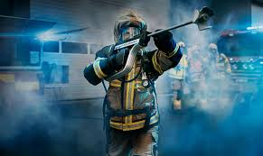
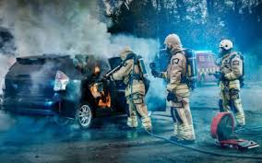
Piercing Nozzles
COLD CUT COBRA
The Cobra Method, including cooling fire gases from a safer place outside the fire compartment, is one of the safest and most efficient firefighting options available to Fire & Rescue Services.
High pressure mist has been shown to more quickly reduce the temperature of an interior space when compared to standard water application.

Slide 6
Piercing Nozzles: Cold Cut Cobra
Pros
Provides access to battery cells from any angle (above, side, or below)
Cons
Expensive
Provides cooling to neighboring cells and could prevent propagation
Uses minimal amount of water
Mobile, can be placed on multiple platforms for access to a variety of locations
Has been utilized by European fire services for over 20 years
Certified for high voltage battery use
Can be used for many different applications beyond just batteries
Can cause thermal runaway upon intrusion
Vehicles will likely reignite at a later time
Towing considerations required
Requires training and maintenance
Places firefighters close to vehicle

Slide 7
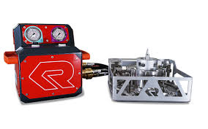
Piercing Nozzles
ROSENBAUER BEST
The Rosenbauer Battery Extinguishing System Technology (BEST) is an extinguishing system for high-voltage lithium-ion batteries in electric vehicles.
Pros
Provides access to the battery cells, typically from underneath vehicle
Cons
Expensive
Could prevent propagation
Less time near vehicle and greater distance during application than other units
In use since 2018 in Europe
Requires precise placement under battery
Difficult to apply when vehicle is on its belly and when vehicle is not upright (may require lifting vehicle)
Vehicles will likely reignite at a later time
Complicated application with multiple moving parts and procedures. Requires training.

Slide 8
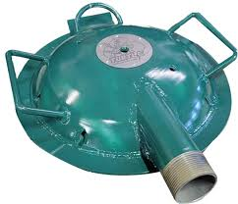
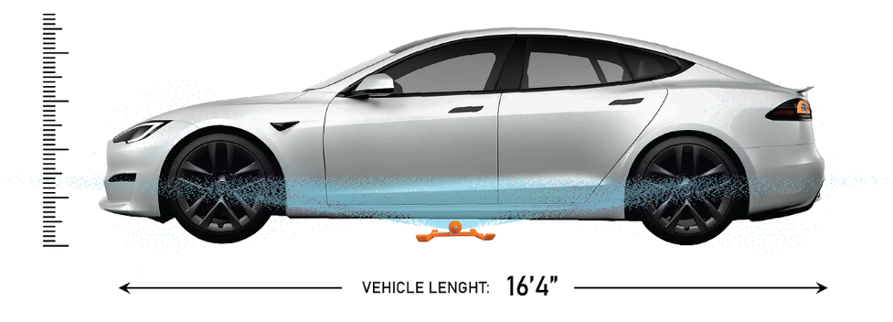
Wetting Nozzles
SUDZ-IT
TURTLE FIRE SYSTEMS
Pros
Applies water to the battery compartment
Cons
Expensive
Minimizes exposures to firefighters
Relatively easy to use
Does not access battery cells
Uses a significant amount of water
Requires vehicle to be elevated off the ground

Slide 9
Firefighting Robots
Reduced firefighter exposure
High flow rate capabilities
  Up to 2,500 GPM
Able plow, tow, and move objects
  Possibly used for towing/moving electric vehicles out of garages (residential or commercial)
Optional Assemblies:
  Winch
    8000 lb / 3629 kg capacity
  Video System
    DTV (standard)
    FLIR thermal (optional)
  Foam Nozzle
  Foam Tank
  Scene Lighting
  PPV Ventilator
    Flow: 9,200 cfm
  Plow Assembly

Slide 10
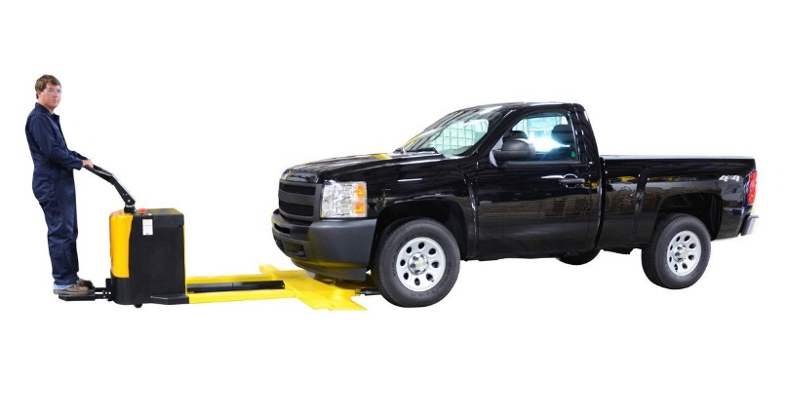
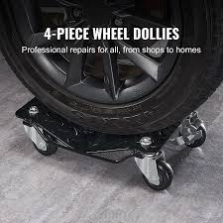
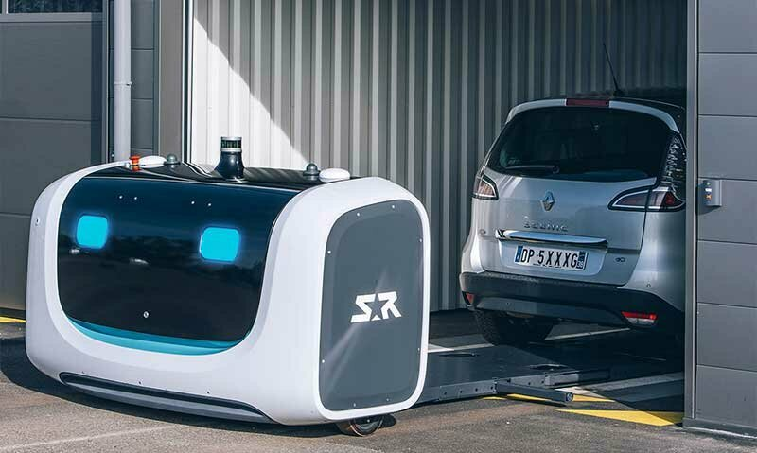
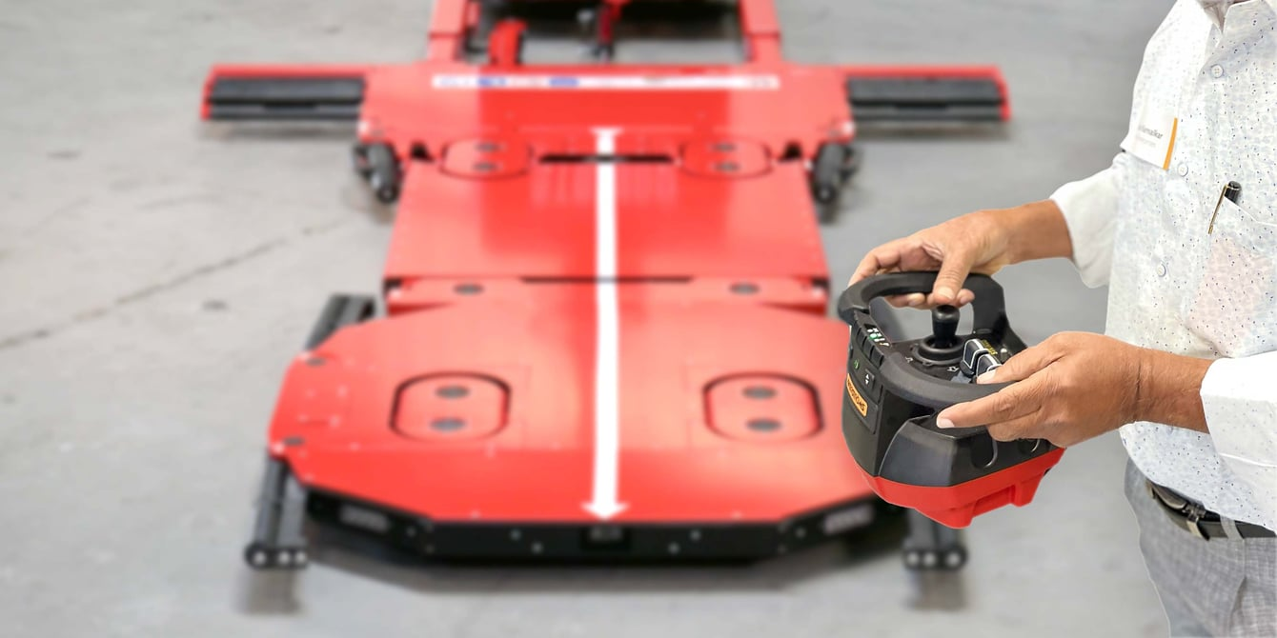
Vehicle Moving
Pros
Moves vehicle without spinning wheels
Cons
Not rated for all EV weights
Can help move vehicles out of tight spaces
Can help move vehicles away from exposures
Turns vehicle into a very heavy free moving object

Slide 11
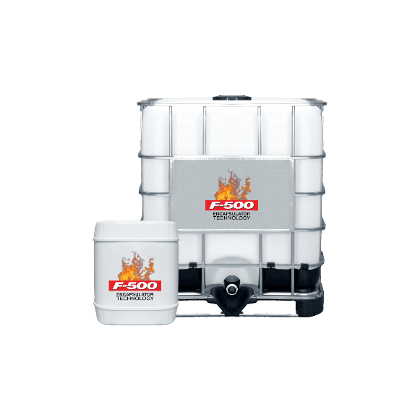
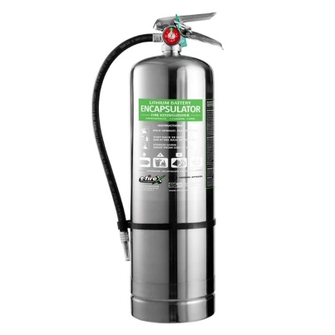
Encapsulating Agents
Forms “chemical cocoons” that encapsulates fuels, rendering them non-flammable and non-ignitable. Additionally, it interrupts the free radical chain reaction of the fire tetrahedron
E-FireX uses an advanced encapsulator agent technology that quickly suppresses fires by extinguishing high-heat flames, encapsulating the fuel, and eliminating toxic vapors
Pros
Can work on traditional fuels
Cons
Battery fires cannot be smothered
Could coat an exposed area and reduce radiant heat exposure
Could assist with smothering a fire beyond water capability
Requires access to the battery cells
May reduce access of water to tight spaces by increasing surface area/volume of material being applied

Slide 12
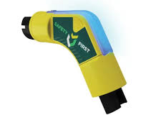
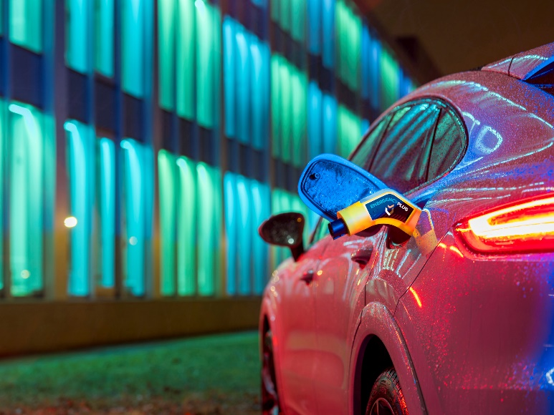
Battery Electric Vehicle (BEV) Tools
EMERGENCY PLUG
The Emergency Plug® (Plug) has been developed to prevent unpredictable vehicle movement by any Full (EV) or Plug-in Hybrid Electric Vehicles (PHEV) in an emergency as well as during regular maintenance.
“As of February 16th, 2024, it has come to our attention that the Emergency Plug® doesn’t disable two specific US car models, the Hummer EV SUV and the Chevrolet Blazer EV. This likely due to a different interpretation of the regulations.”

Slide 13
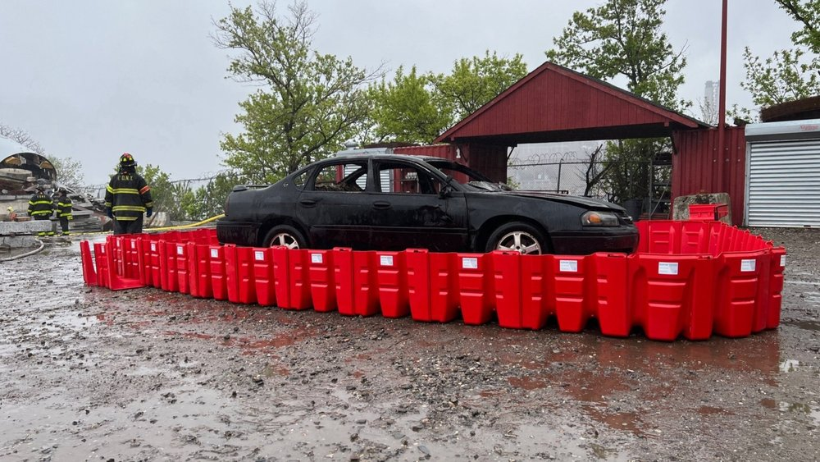

Submersion
Pros
Contains runoff… mostly
Cons
Water needs to be managed
Cools battery pack and reduce radiant heat threat
Buy time for removal plan
Relatively quick to deploy anywhere
Vehicle will likely reignite at a later time
Water exposure to batteries may cause further battery damage to uninvolved batteries
Does not remove vehicle from area

Slide 14
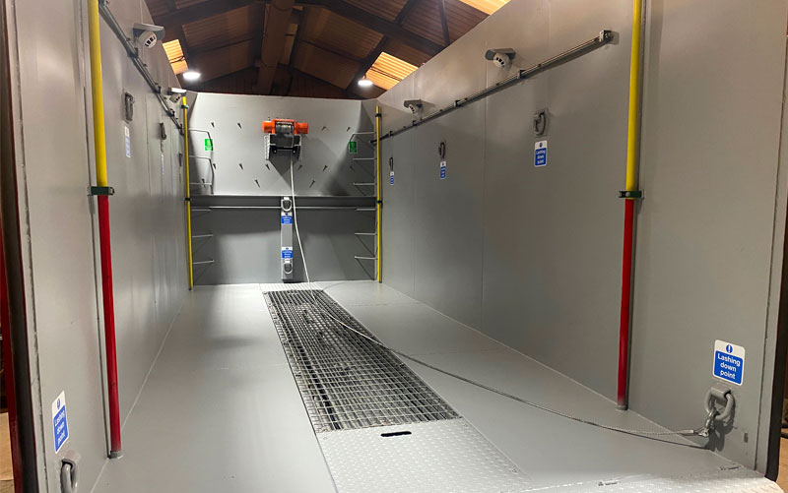
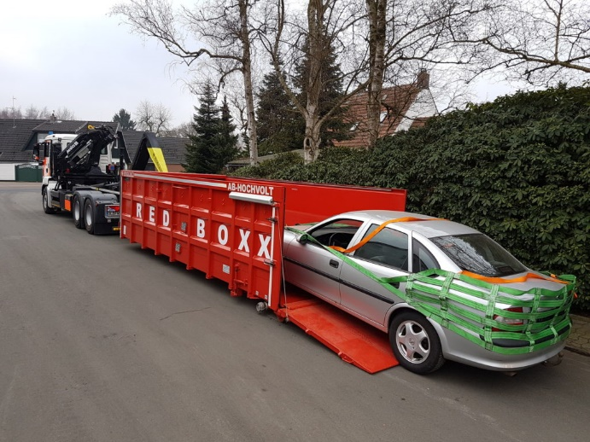
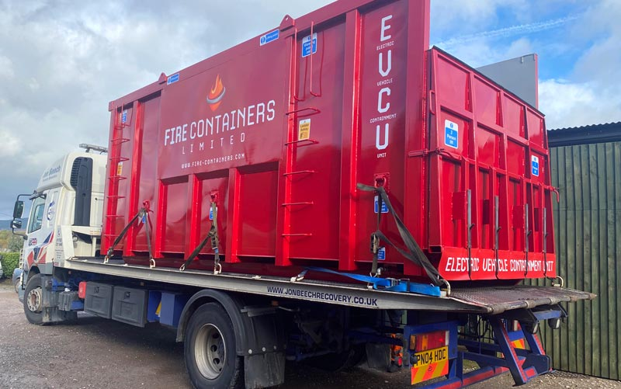
Submersion + Containers
Pros
Remove vehicle on fire from unwanted location
Cons
Water needs to be managed
Cool battery pack and reduce risk of battery projectiles
Provide a storage tool for tow yards to reduce required footprint for storage/staging
Some are high tech with monitors, sensors, sprinklers, etc.
Vehicle will likely reignite at a later time
Water exposure to batteries may cause further battery damage to uninvolved batteries
Requires tow company to transport a container with DDR batteries under water
Is there a permitting or hazmat waiver required? Is there going to be?

Slide 15
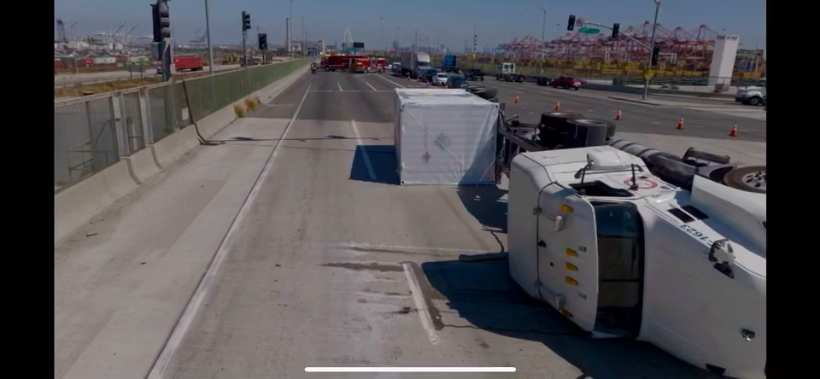
Heavy Wreckers + Tow

Slide 16
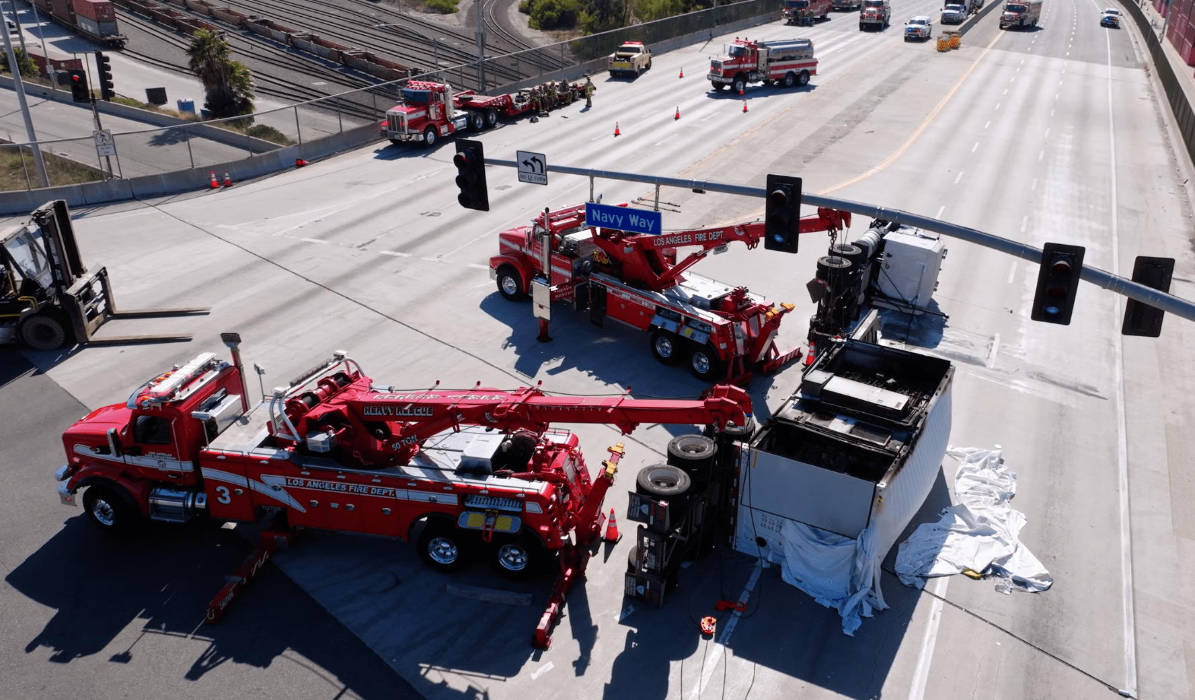
Heavy Wreckers + Tow
Pros
Remove BESS or vehicles from unwanted location
Cons
Expensive
Upright heavy equipment
Reduce impact to commerce
Reduce exposure to public
Maintenance costs
Requires training and licensing for operations
Staffing/Cross Staffing challenges

Slide 17
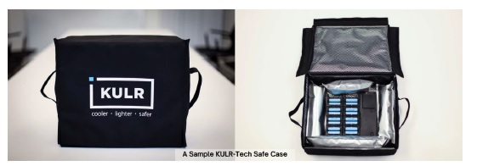
Storage Options: Kulr Safex
Pros
DOT Special Permit
Cons
Allows off-gassing
Packaging of multiple cells up to 2.6 kWh
Affordable
Portable
Available in USA
Passes propagation testing standards
Fire could be seen during heavy testing

Slide 18
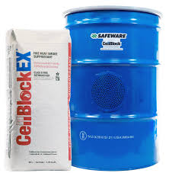
Packaging Options: Cellblock EX
Pros
DOT Special Permit
Cons
Expensive
Packaging of multiple cells up to a standard gross weight
All labels provided
Readily available and widely used in USA
Easy packing instructions
Overpressure protection drums available
First-hand experience of drum over pressurization and/or failure to contain fire
Overpressure protection drum was required to be made available
Allows for off-gassing

Slide 19
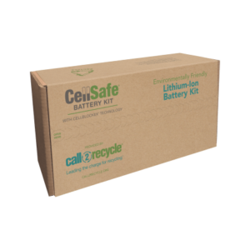
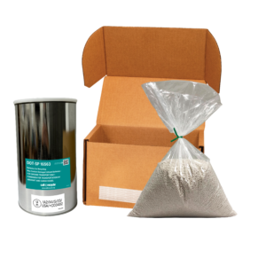
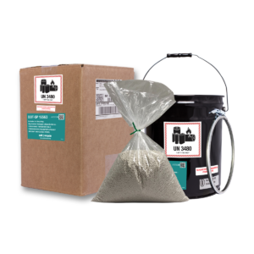
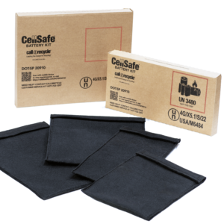
Packaging Options
CellBlock Cell Safe
CellBlock Cell Safe
Small DDR Li-Ion Kit
Call2Recycle Large
Pros
Readily available
Cons
No vent for off-gassing
Easy to use
All labels provided
Deflagration possible
First-hand experience of fire occurring in container

Slide 20
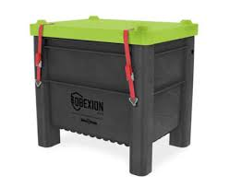
Packaging Options: DGEO Obexion
Obexion AG with Akkugrain
Obexion FR with Akkugrain
Pros
DOT Special Permit
Cons
Expensive
Packaging of multiple cells up to 11 kWh
Withstood rigorous testing with no radiant heat, no fire outside unit, and no acid gases present
Available in USA
Easy packing instructions
Easy to load and unload
Allows off gassing of flammable gases (H₂, CO, etc.) and products of combustion (HCN, smoke, etc.)

Slide 21
Breakout Session: Tools for Response
Fire blankets
Foam / Additives
Piercing nozzles
Cooling nozzles
Vehicle Submersion
DDR packaging options
Select one of the tools above and develop a Pros/Cons List based on information you find online or from this presentation.
Be prepared to present this to the class.

