Slide 1
Lithium-Ion Battery Response Training
General Operations for Lithium-Ion Battery Sites

Slide 2
Overview
Lithium-ion battery sites vary in size and scope
Cleanup approach is site-specific
Operational Modules are flexible—apply as needed
Goal: Safe, cost-effective operations

Slide 3
Every Site We Work
Triage
Determine hazards
Determine potential exposures
Segregate hazards
Eliminate hazards
Through neutralization or solidification
Off-site disposal
Containment on-site
Establish an Exit Plan
Identify bottlenecks
Shipping and disposal are most common bottlenecks

Slide 4
Operations Modules
Site Set-up and Stabilization
Battery Pack Disassembly
De-energizing and Brining
Battery Deconstruction
Packaging and Transportation
Disposal

Slide 5
Site Set-up and Stabilization
Site Footprint
Fire Preparedness
Air Monitoring Considerations
  SPM, AreaRae, potentially DustTrak
PPE
Decontamination

Slide 6
Battery Pack Disassembly
Optional step based on site needs
Conduct when:
  Pack is waterproof and prevents de-energizing
  Cell evaluation is required
  Shipment requires deconstruction
  Not always necessary for small/intact packs

Slide 7
De-energizing and Brining
For energized, damaged DDR batteries
Not needed if batteries are clearly undamaged
NEVER assume all batteries are safe
De-energizing Methods
  Resistive Discharge
  Brining

Slide 8
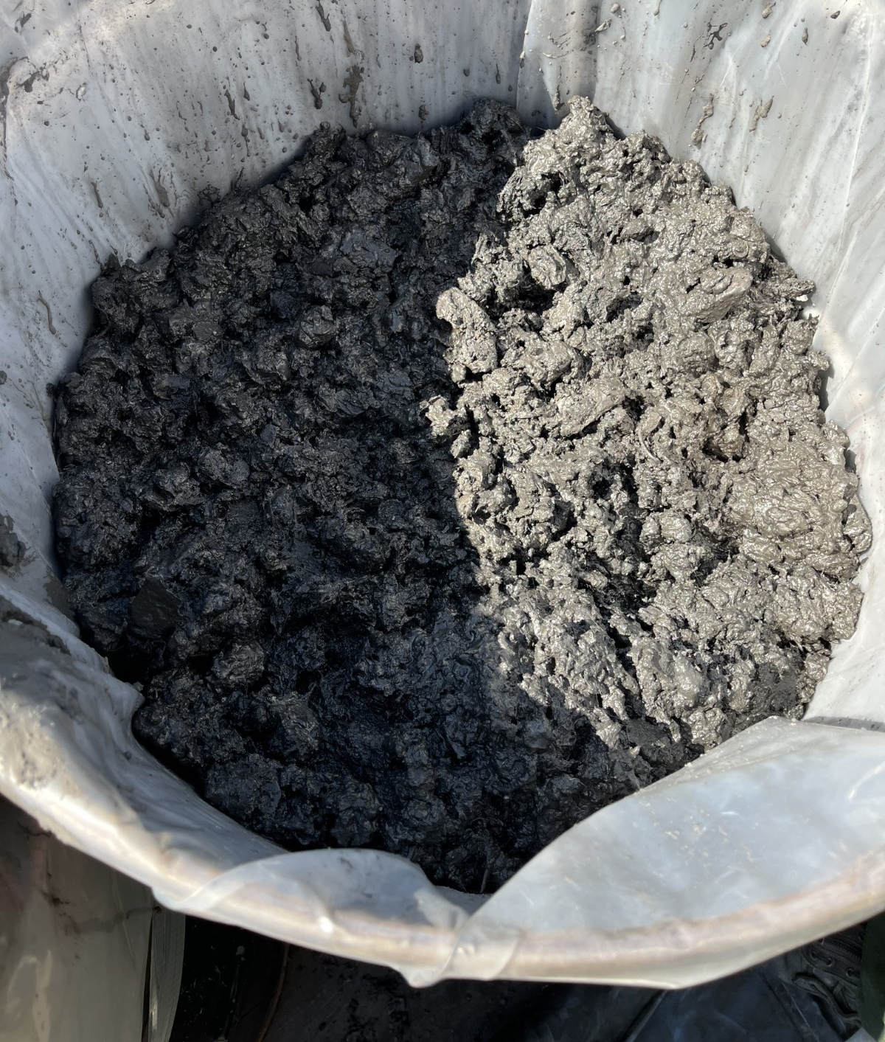
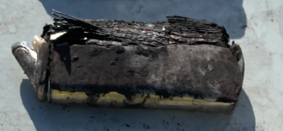
Battery Destruction
Consider when DDR shipping costs are excessive or shipment is impossible
Must follow RCRA and hazardous waste rules
Deconstruction makes batteries "not batteries", speaking regulatorily, but still a waste that needs to be characterized/profiled

Slide 9
Packaging and Transportation
Transportation regulations applies to nearly all lithium-ion battery sites
DOT regs vary based on battery condition
Deconstructed = “not batteries” → shipping regs based on waste characteristics
Intact = subject to full battery shipping regulations
  Regardless of state of charge
  Likely DDR shipping regs

Slide 10
Disposal
Recycling is preferred
  More expensive
  More restrictive
Disposal/Landfilling is more complicated than normal waste
  Due to newness
  May require testing outside of normal waste profiling testing (e.g. leachate reactivity testing in SoCal)

Slide 11
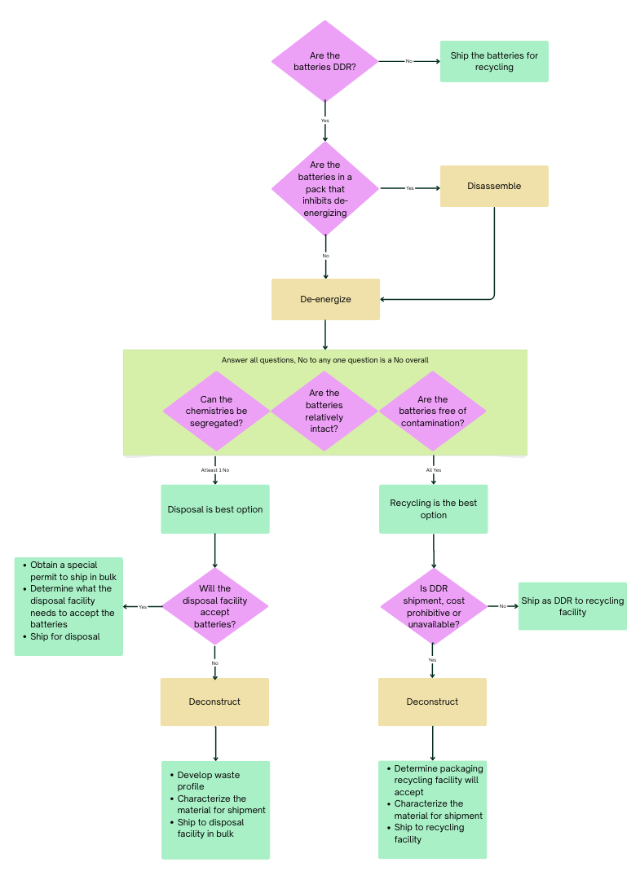

Slide 12
Questions?

