Slide 1
Lithium-Ion Battery Response Training
Packaging, Shipment, and Transportation of “Not Batteries”

Slide 2
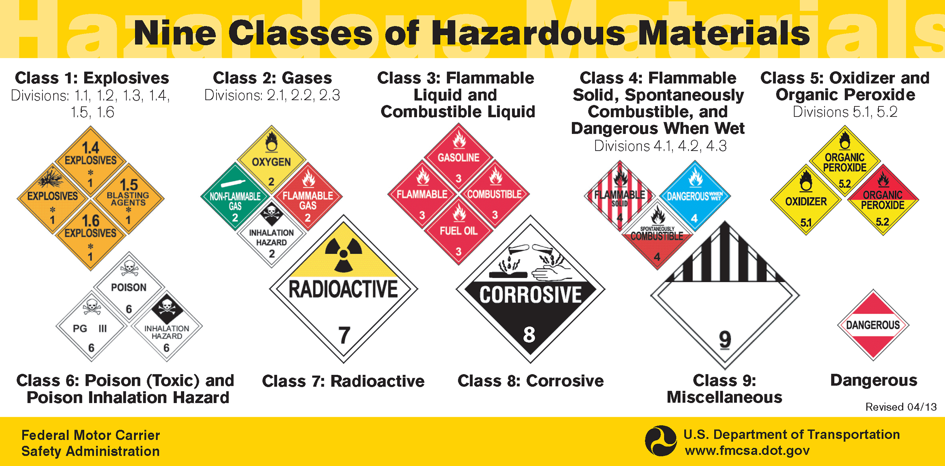
Characterization for Shipment
Evaluate the EPA and DOT definition of a lithium-ion battery to determine it no longer meets the definition
Characterize the material according to DOT Hazard Class
Does it meet Hazard Class 4 – Flammable Solids?
  49 CFR 173.124
  Solid materials that pose a serious risk of fire in uncontrolled conditions.

Slide 3
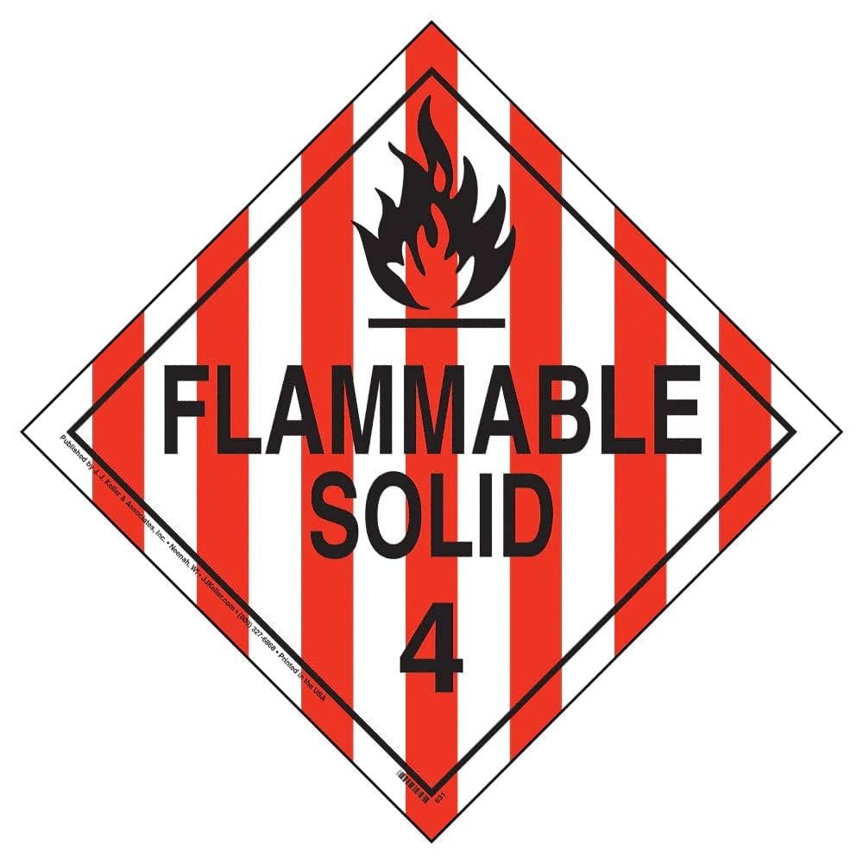
Class 4.1: Flammable Solid
Flammable solids are readily combustible or may contribute to a fire through friction. Examples include:
  Solid desensitized explosives
  Self reactive materials
  Readily combustible solids
  Polymerizing materials

Slide 4
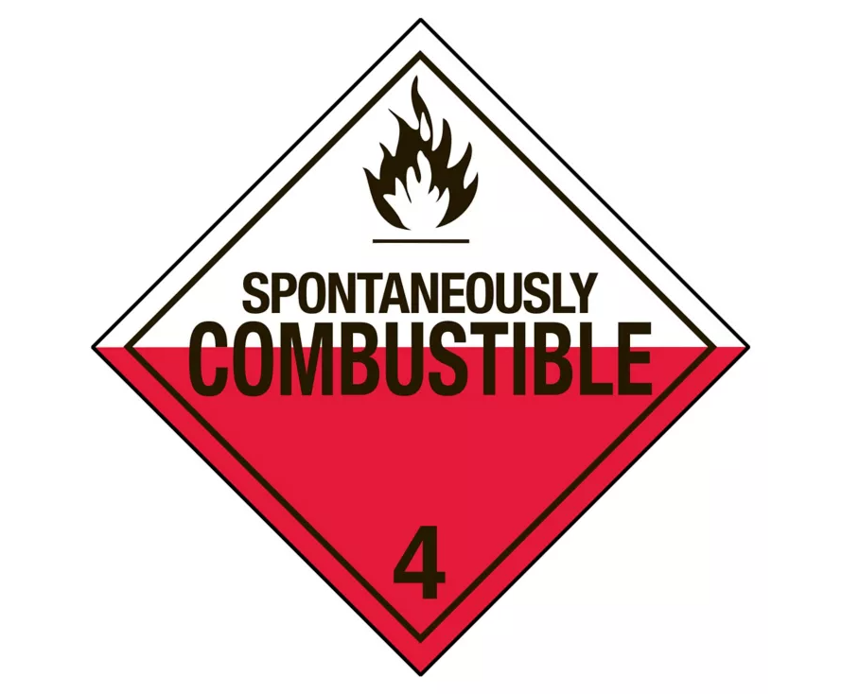
Class 4.2: Spontaneously Combustible
Spontaneously combustible materials are liable to spontaneous generation of heat during transportation which can then lead to a fire. These include:
    Pyrophoric substances
    Self-heating substances

Slide 5
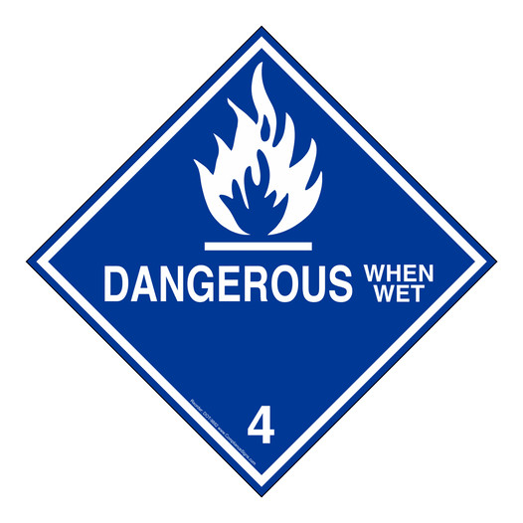
Class 4.3: Dangerous when Wet
Dangerous when wet means a material that, by contact with water, is liable to become spontaneously flammable or to give off flammable or toxic gas at a rate greater than 1 L per kilogram of the material, per hour, when tested in accordance with UN Manual of Tests and Criteria.

Slide 6
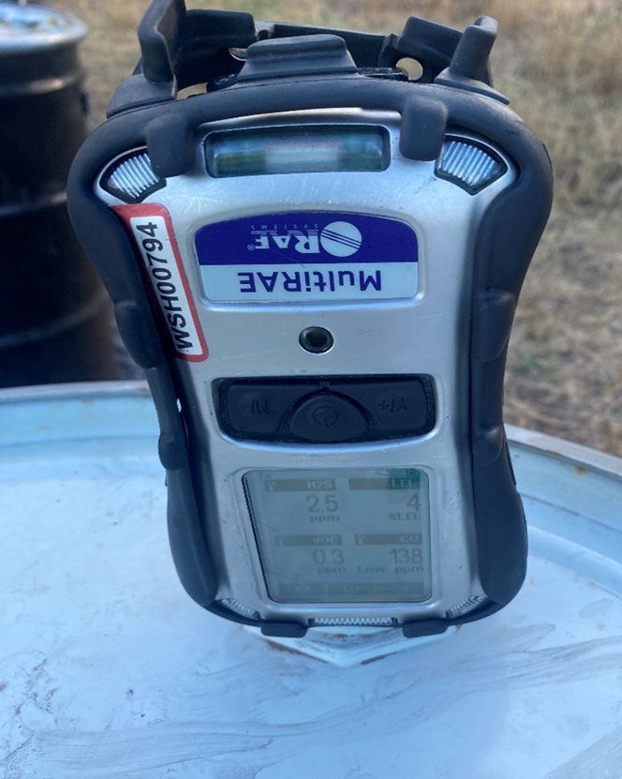
Maui Wildfires Hazard Class Determination
Hydrogen gas still being generated at low levels
  United Nations (UN) N.5 Test for Water Reactive Materials that emit flammable or toxic gas
    Requires flammable gas production greater than 1 liter per kilogram of substance/hour
  Drums sealed and pressure/temperature measured – never pressurized, ambient temp
No Hazard Class needed

Slide 7

Class 9: Miscellaneous Hazardous Material
173.140 Class 9—Definitions.
(b) Any material that meets the definition in § 171.8 of this subchapter for an elevated temperature material, a hazardous substance, a hazardous waste, or a marine pollutant.

Slide 8
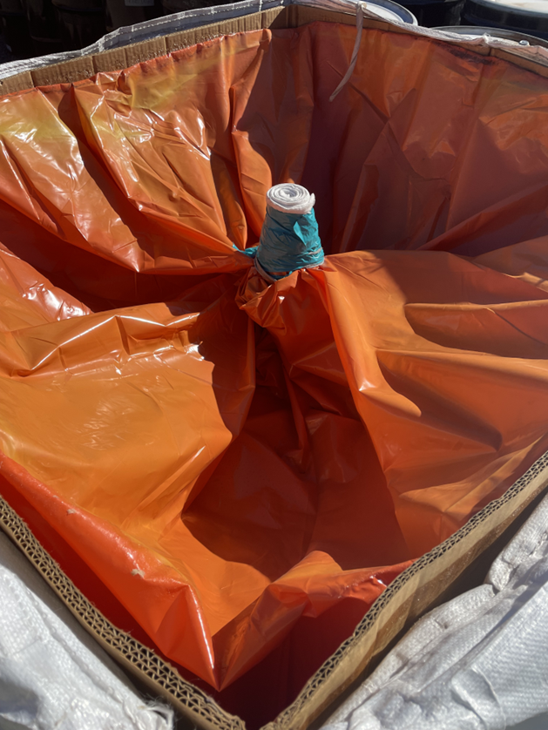
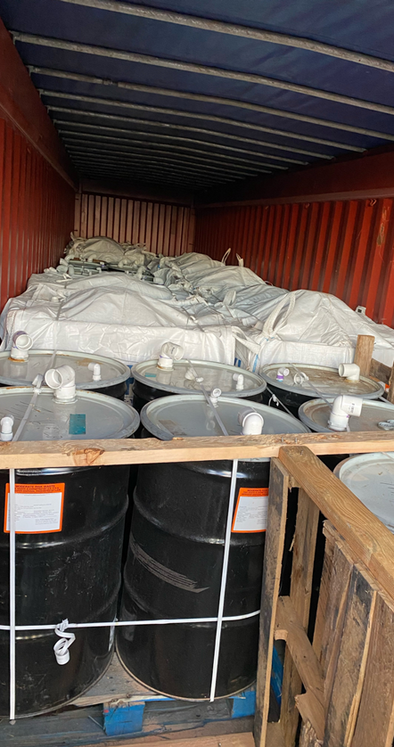
Maui Wildfire Shipping Conditions
Modified performance packaging - snorkel drum, yard box with filter
Measured maximum of 2.5% LEL for H2 in snorkel & filter
Open top shipping container to ensure no gas buildup- verified never above 2.5% LEL
Ventilation
Particulate control
Water intrusion control

Slide 9
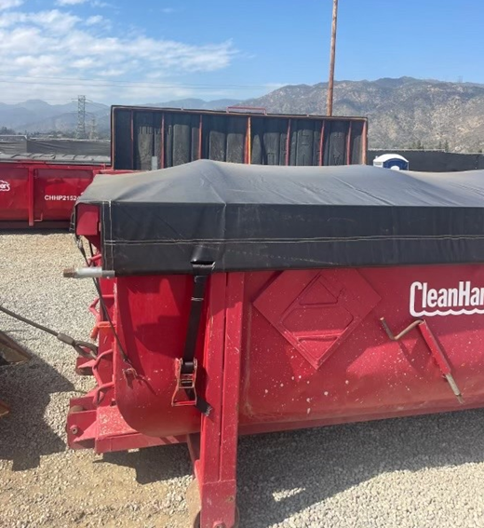
SoCal Wildfires Hazard Class Determination
  First attempt at bulk disposal using roll-offs.
    Assumption of same classification as Maui based on similar material and field hazcat results
    Air monitoring investigation determined that ventilation was necessary for transportation due to H₂ accumulation/LEL.
    Liners used to include adding an absorbent to collect any liquid that could leach from material

